Slide 1
Information System for RESPOND Projects
N.K.AISHWARYA (1602-14-737-064)
K.SUSRUTHA (1602-14-737-115)

Slide 2
About:
Collect the details of a person for joining an organization as an intern or as an employee

Slide 3
Softwares used
Languages used:
Windows
postgreSQL
HTML
CSS
JavaScript
PHP

Slide 4
Existing System:
Filling forms offline
Incorrect submission of forms

Slide 5
Proposed System:
Notify the users about errors
validate the forms
store the data

Slide 6
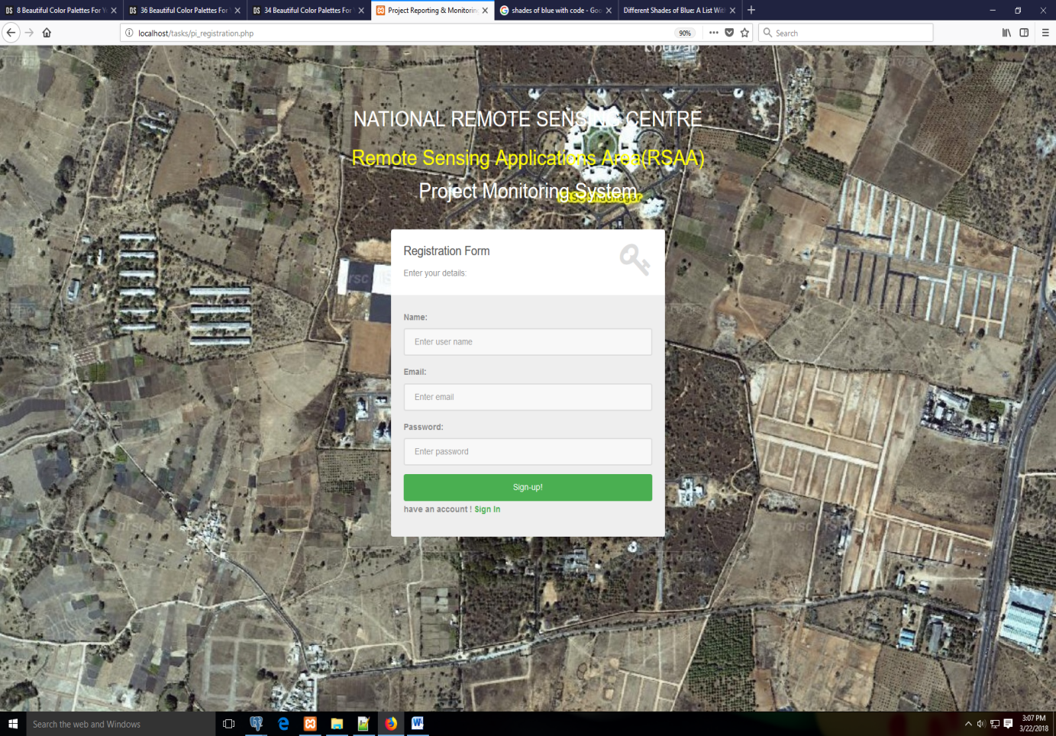

Slide 7
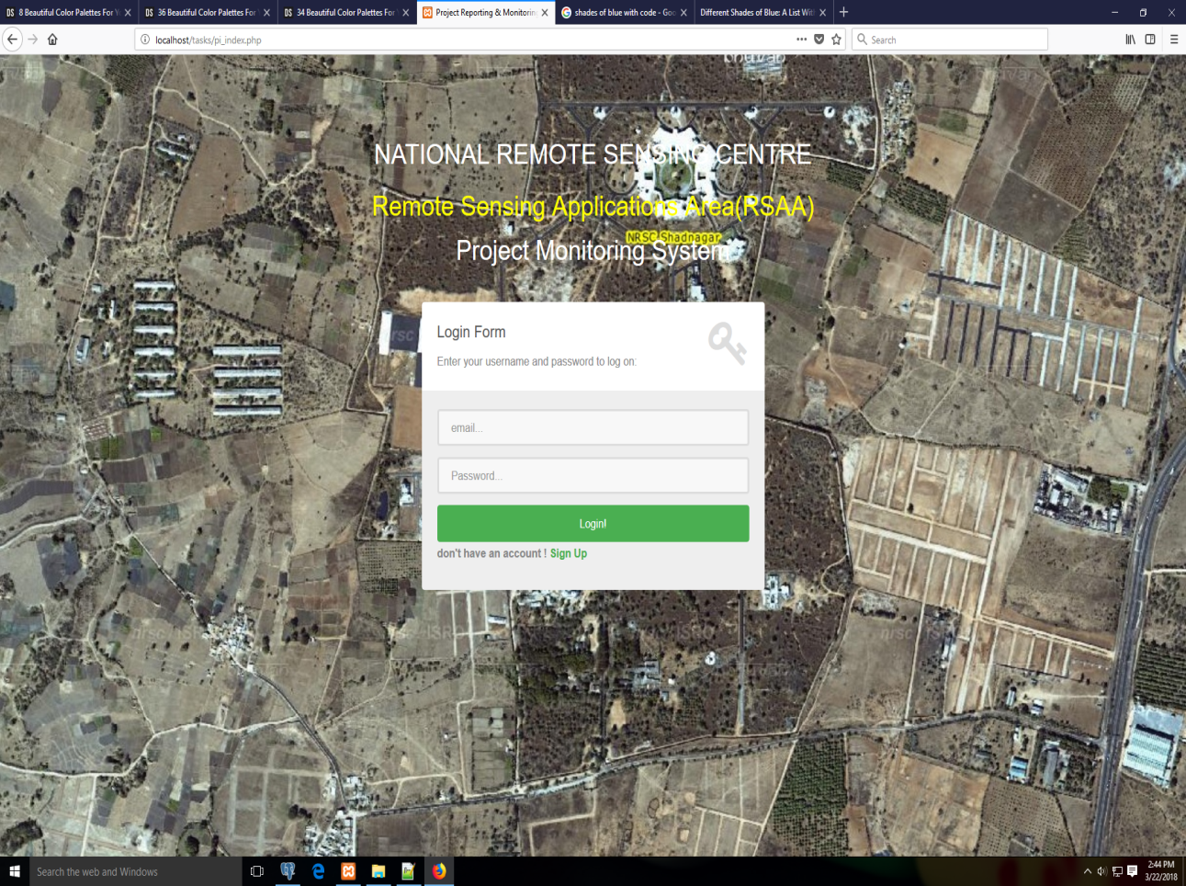

Slide 8
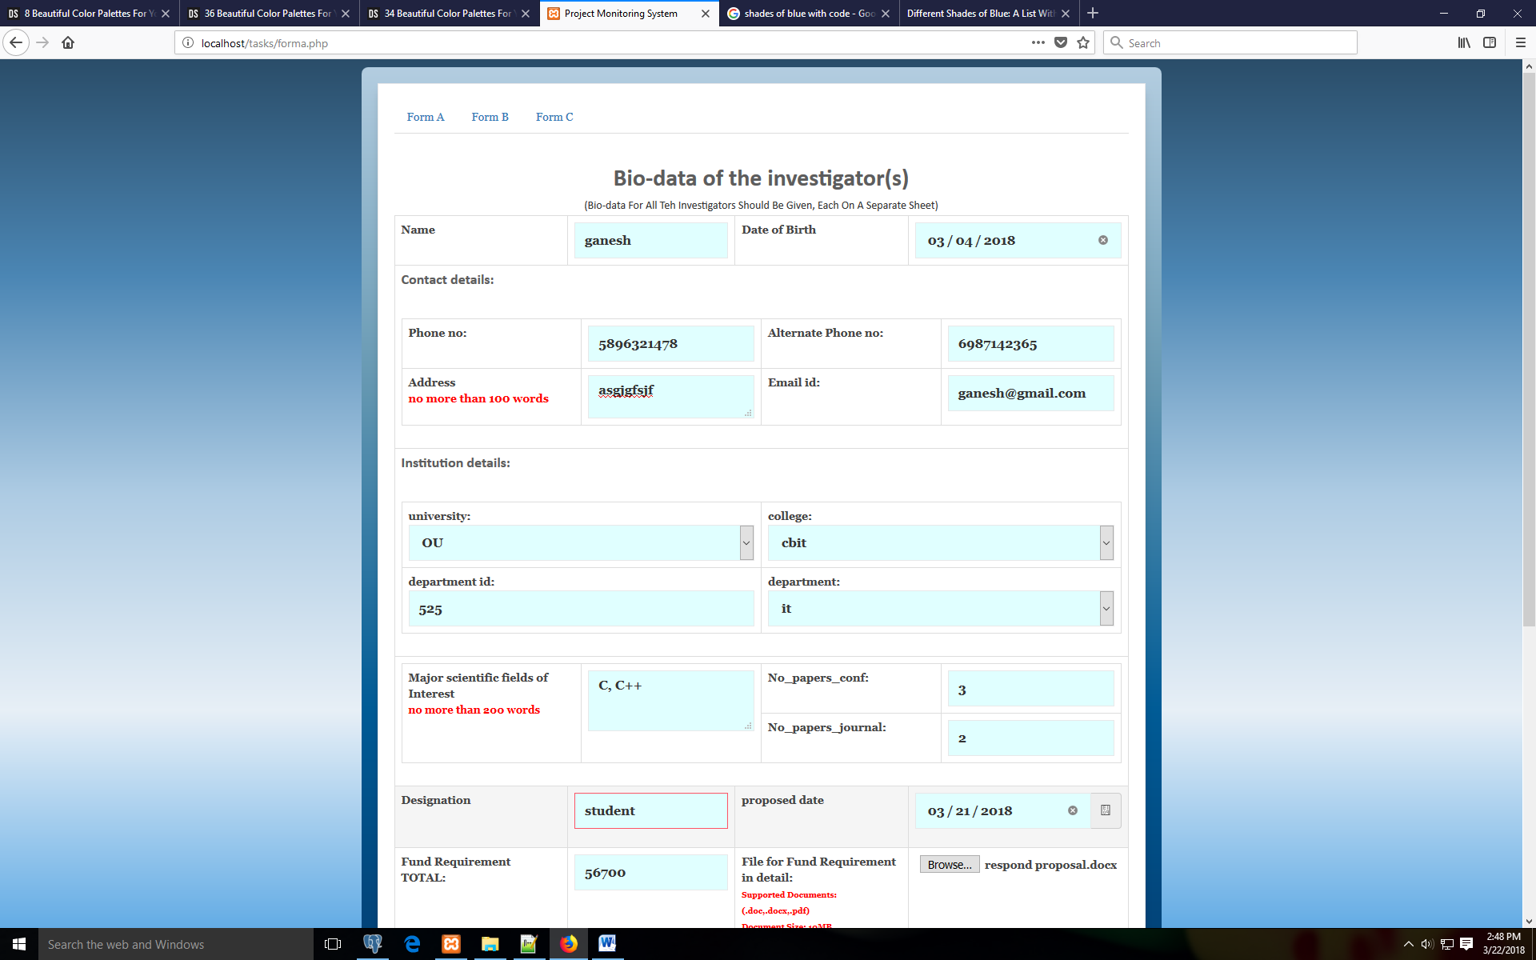

Slide 9
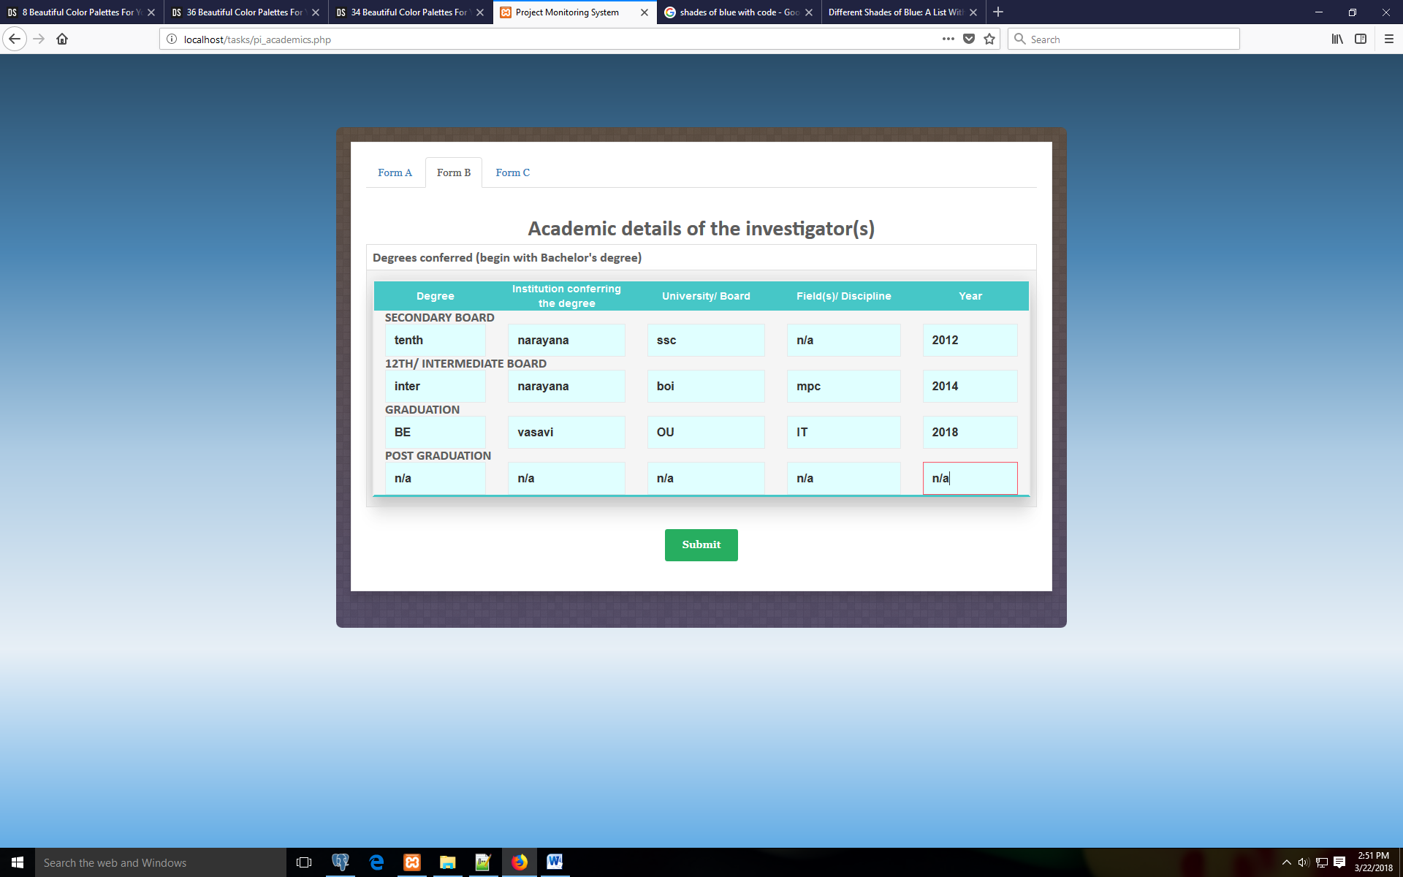

Slide 10
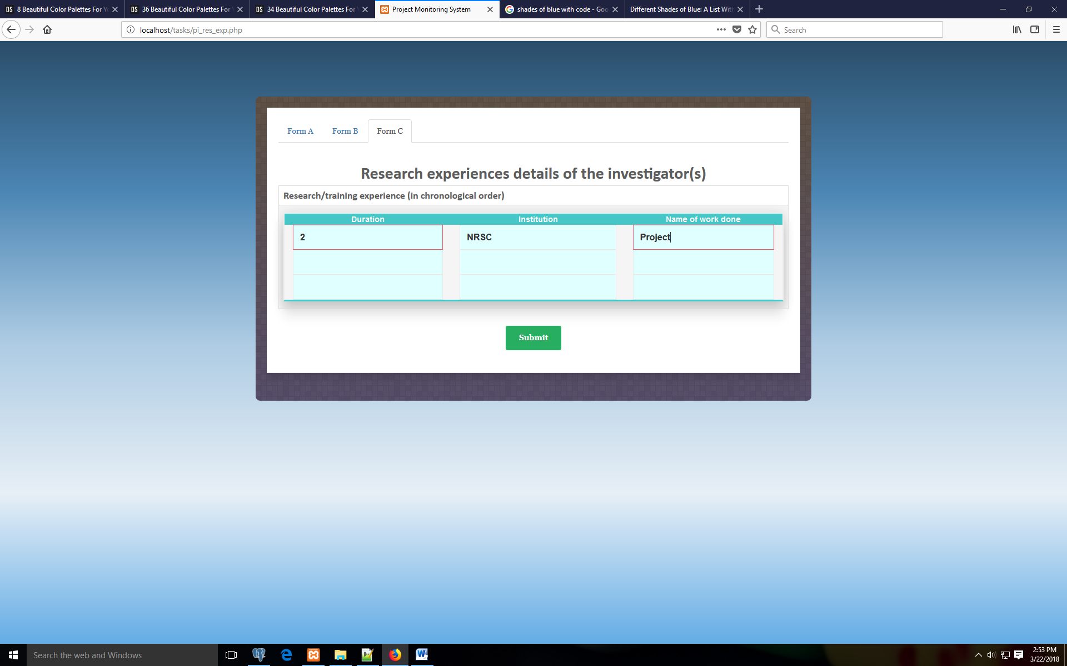

Slide 11
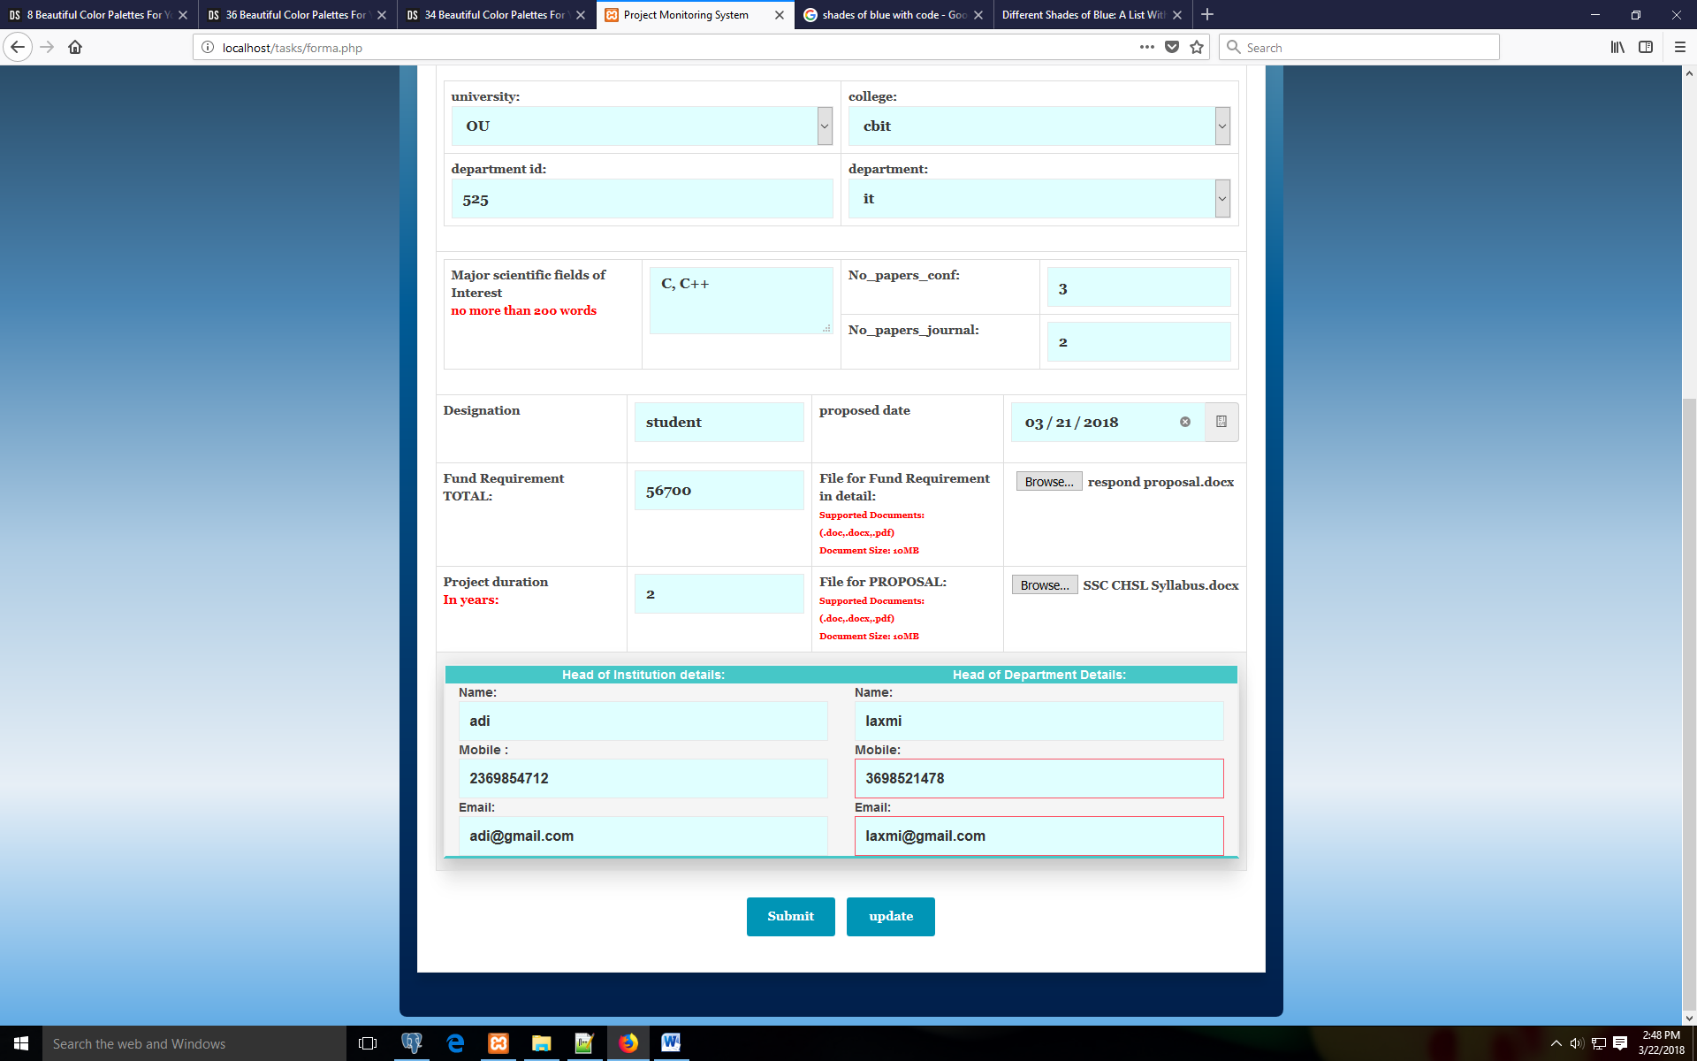

Slide 12
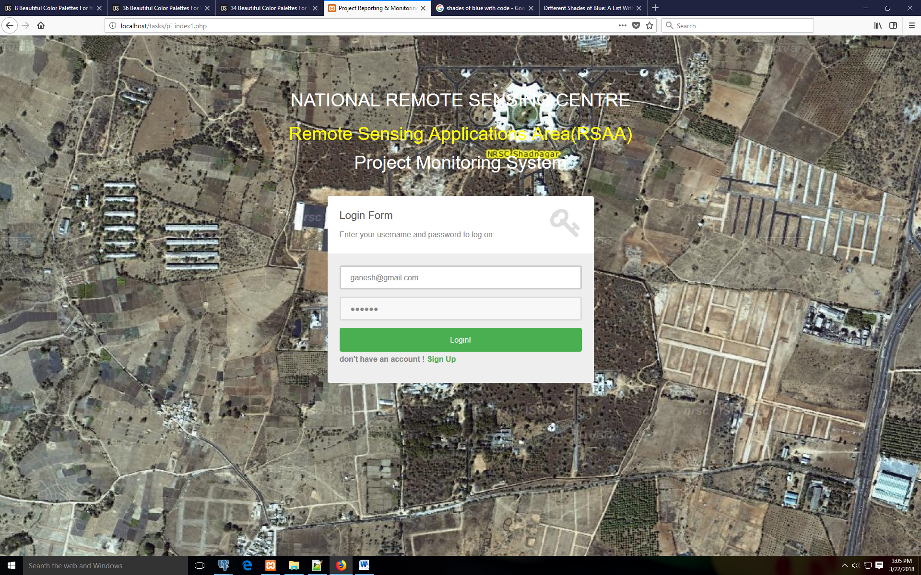

Slide 13
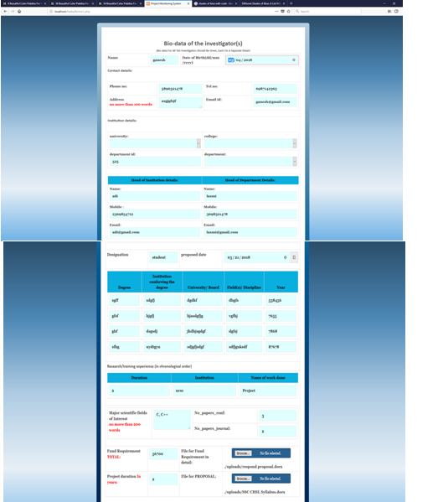

Slide 14
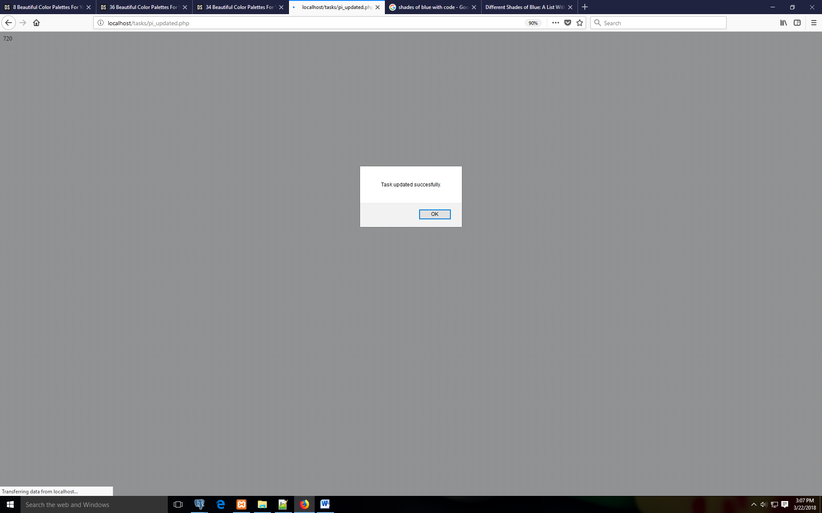

Slide 15
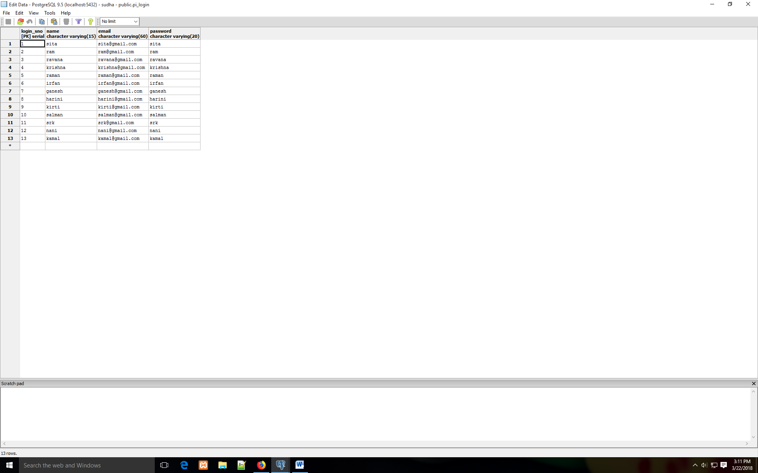
Database:

Slide 16
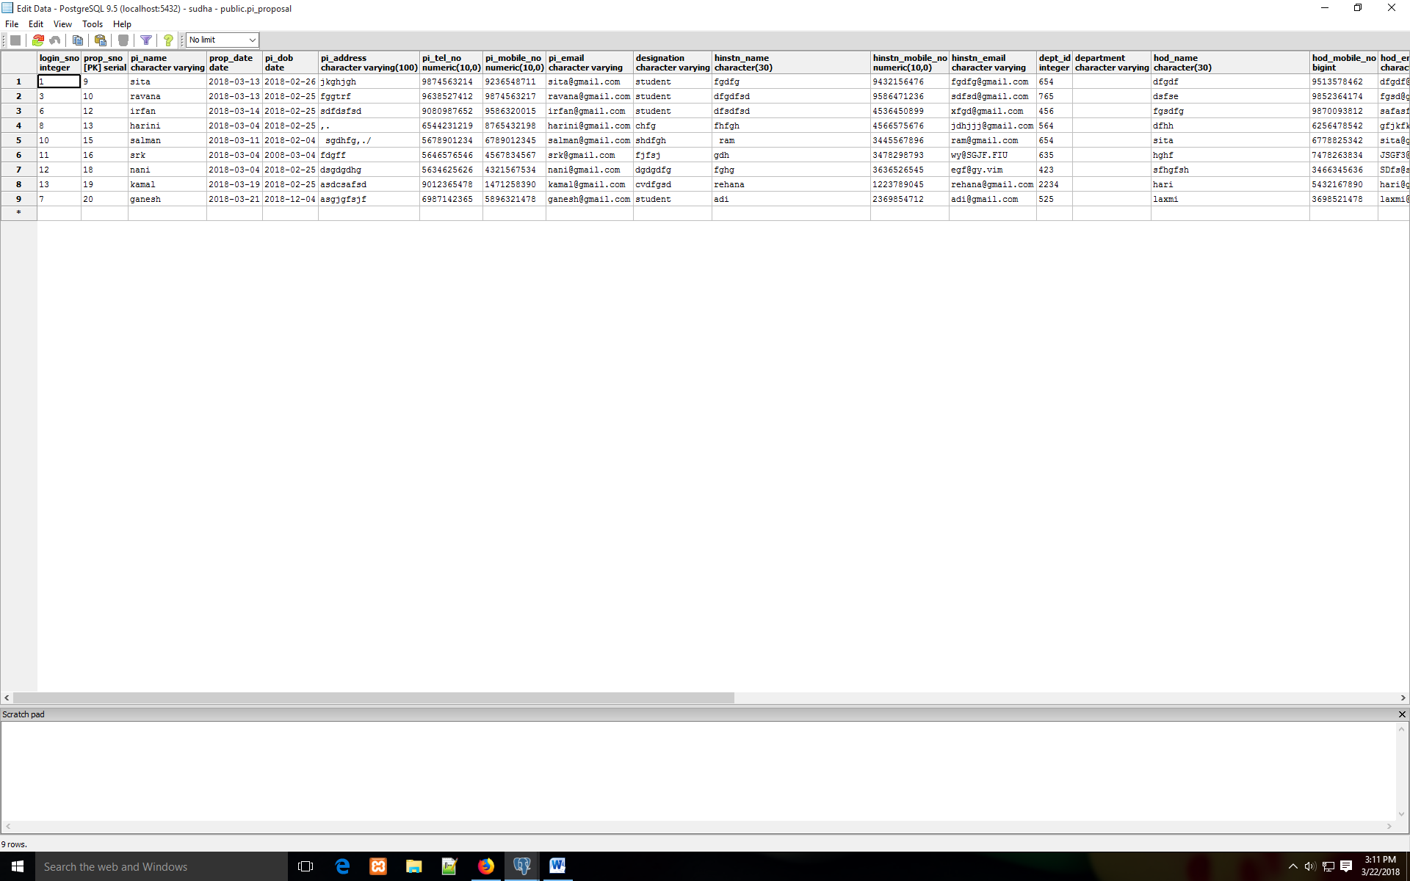

Slide 17
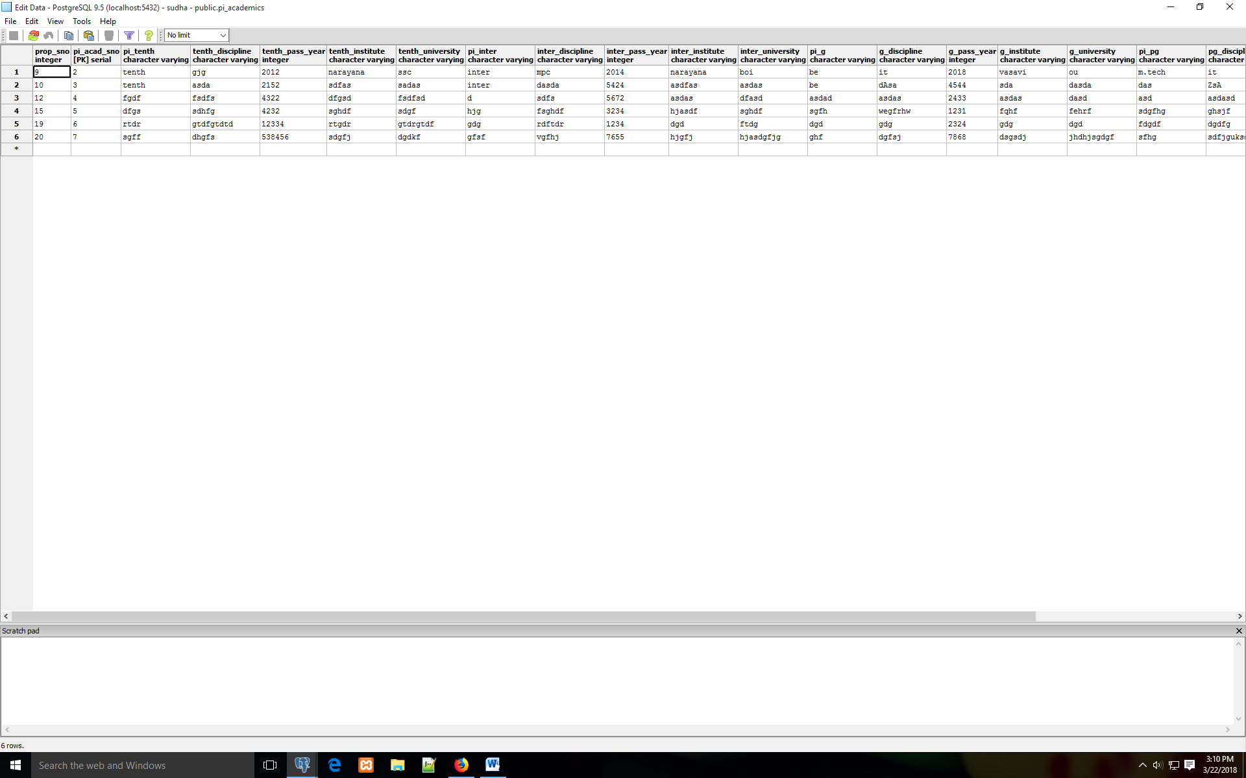

Slide 18
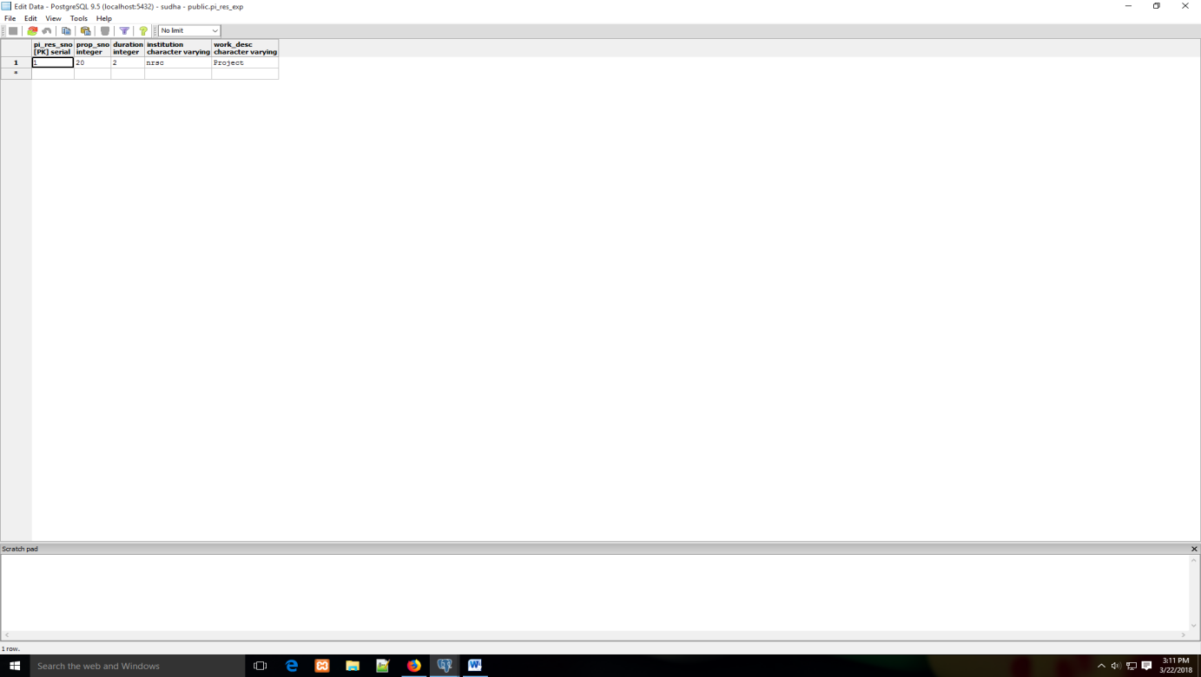

Slide 19


